Slide 1

623.504 House Pricing Prediction Rafael Aghashirinov
Dataset: https://www.kaggle.com/datasets/muhammadbinimran/housing-price-prediction-data

Slide 2
Table of Contents
Motivation
Learning Task
Preliminary data analysis
First implementation of an ML approach
Obtained results, and their analysis.

Slide 3
Motivation
My motivation for this project is to provide a valuable tool for homebuyers, sellers, and real estate investors alike by predicting housing prices accurately.
The goal of this project is to use machine learning techniques to create a robust predictive model that can estimate housing prices based on relevant factors such as rooms, property size, neighborhood amenities, and so on
Notes:
By automating this process, we can streamline decision-making in the real estate market and empower individuals with more accurate insights into property valuations.
Through the analysis of extensive housing data, I aim to develop a model that predicts property prices. This knowledge can enable more informed decisions regarding property investments and transactions.

Slide 4
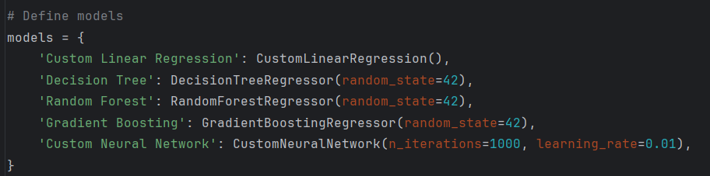
Learning Task
The learning objective is centered around instructing a machine learning system to forecast housing prices using a collection of input characteristics drawn from the "Housing Price Prediction Data" dataset, obtainable on Kaggle.
Subsequently, we will investigate various machine learning methodologies appropriate for regression tasks, including linear regression, decision trees, random forests, gradient boosting, and neural networks

Slide 5

Literature Overview
The literature on house price prediction is rich and diverse, encompassing a wide range of methodologies and perspectives. From traditional econometric models to machine learning techniques
Relevant Literature:
Li, Y., & Li, W. (2020). House Price Prediction Based on Support Vector Machine and Artificial Neural Network. IEEE Access.
Nagel, S. (2020). Big Data and Machine Learning in Quantitative Investment. University of Chicago Press.
Forrest, R., & Murie, A. (1994). Housing Markets and Housing Institutions: An International Comparison. Routledge.

Slide 6

PRELIMINARY DATA ANALYSIS
Dataset description: The dataset used in this analysis is a housing price dataset. It includes various features that describe the attributes of houses
Input data:
A numerical feature representing :
SquareFeet
Bedrooms
Bathrooms
YearBuilt
Neighborhood
Price
Output Data:
Price: A numerical value representing the price of the house.
Data Preprocessing:
Splitting Features and Target Variable
Defining Numerical and Categorical Features
Creating Transformers for Preprocessing
Combining Transformers using ColumnTransformer

Slide 7
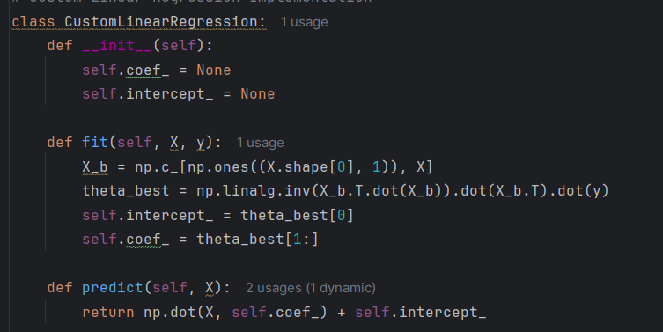
Implementation
To address the housing price prediction task, a robust model is required to handle various features of houses and accurately estimate their prices. I implemented multiple machine learning models to determine the most effective approach for predicting housing prices. Each model was trained to understand the relationships between different features and housing prices.
Linear Regression - provides a baseline for prediction performance.
Initialize two attributes . These attributes will later store the coefficients (slopes) and intercept (bias) of the linear regression model after it has been fitted to the data.
Trains the linear regression model on the given training data.
Make predictions on new data using the trained model
Notes:
fit method:Purpose: This method trains the linear regression model on the given training data (X for features and y for the target variable).
Step-by-step explanation:
X_b = np.c_[np.ones((X.shape[0], 1)), X]:
This line adds a column of ones to the feature matrix X to account for the intercept term in the linear regression equation. This is often referred to as the bias trick.
np.c_ is used to concatenate the column of ones (which has the same number of rows as X) with the original feature matrix X.
theta_best = np.linalg.inv(X_b.T.dot(X_b)).dot(X_b.T).dot(y):
This line computes the optimal values of the parameters (coefficients and intercept) using the normal equation: theta = (X^T * X)^(-1) * X^T * y.
X_b.T is the transpose of X_b.
X_b.T.dot(X_b) computes the dot product of X_b transposed and X_b.
np.linalg.inv(...) computes the inverse of this product.
The resulting inverse is then multiplied by the dot product of X_b.T and y.
The result theta_best is an array where the first element is the intercept, and the remaining elements are the coefficients.
self.intercept_ = theta_best[0]:This line assigns the first element of theta_best to self.intercept_.
self.coef_ = theta_best[1:]:This line assigns the remaining elements of theta_best to self.coef_.
predict method:Purpose: This method makes predictions on new data using the trained model.
Step-by-step explanation:
np.dot(X, self.coef_) + self.intercept_:
This line computes the dot product of the input feature matrix X and the learned coefficients self.coef_, and then adds the learned intercept self.intercept_ to each prediction.
The result is an array of predicted values for the target variable based on the input features.

Slide 8
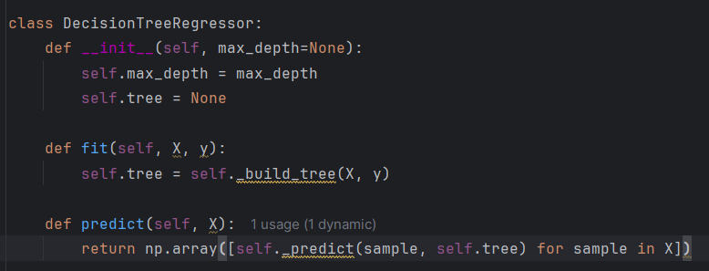
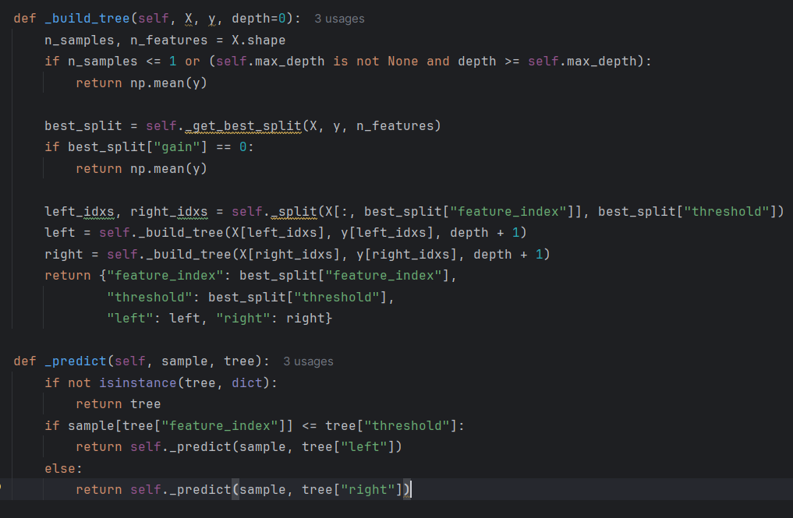
Implementation
Decision Tree Regressor - split the data into subsets based on feature values to minimize the variance within each subset.
1. Initialize the model with a maximum depth parameter.
2. Fit the model by recursively splitting the data to build a tree.
3. Find the best split based on information gain (variance reduction).
4. Make predictions by traversing the tree from the root to a leaf node.

Slide 9
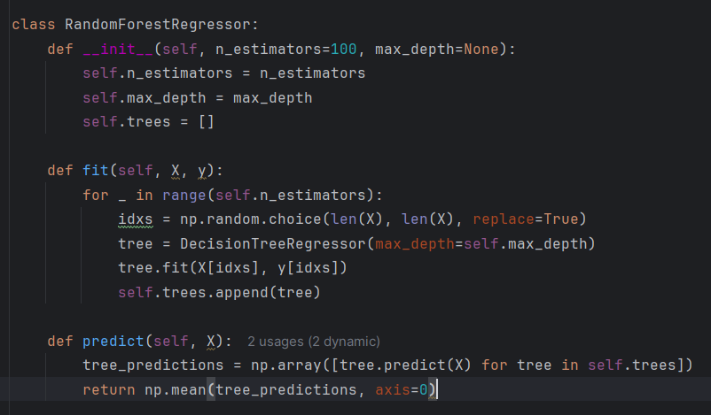
Implementation
Random Forest Regressor- builds multiple decision trees on random subsets of the data and averages their predictions.
1. Initialize the model with the number of estimators (trees) and maximum depth.
2. Fit the model by building multiple decision trees on bootstrapped subsets of the data.
3. Aggregate the predictions of all trees to make the final prediction.
4. Predict by averaging the outputs of all individual trees.

Slide 10
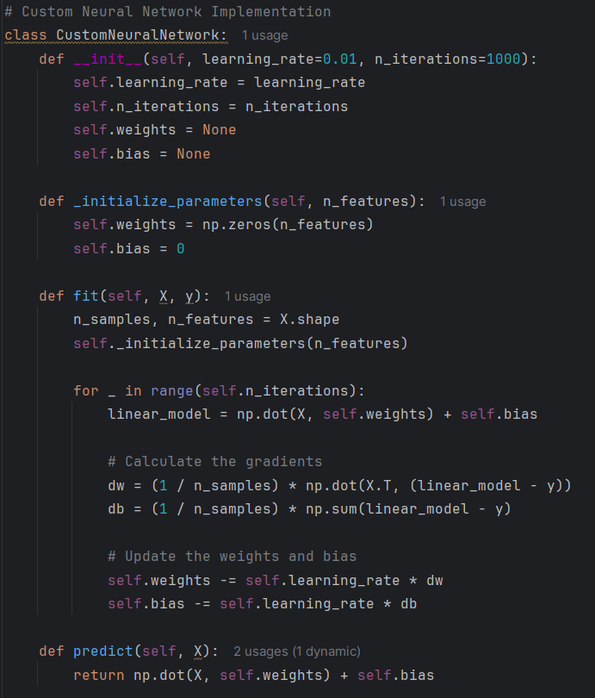
Implementation
Neural Network - A simple feedforward algorithm with one hidden layer, trained using back propagation.
The model is initialized with a specified learning rate and number of iterations (epochs) for training.
Parameters such as weights and bias are initialized within the class.
Training Loop: For each iteration (epoch):
Forward Pass: Calculate the linear combination of inputs and weights, then apply the sigmoid activation function to get the predicted output.
Compute Gradients: Calculate the gradients of the loss function with respect to the weights and biases.
Backward Pass: Update the weights and biases using the gradients and the specified learning rate.
Make predictions using the trained network by performing a forward pass.
Notes:
Neural Network consist of layers of interconnected nodes (neurons), where each connection has a weight that is adjusted during training.
fit method:Purpose: Train the neural network on the provided dataset.
Step-by-step explanation:
n_samples, n_features = X.shape: Gets the number of samples and features from the input data X.
_initialize_parameters(n_features): Initializes weights and bias.
linear_model = np.dot(X, self.weights) + self.bias: Computes the linear combination of input features and weights, adding the bias.
Gradient Calculation:dw = (1 / n_samples) * np.dot(X.T, (linear_model - y)): Computes the gradient of the loss with respect to the weights.
db = (1 / n_samples) * np.sum(line_model - y): Computes the gradient of the loss with respect to the bias.
Parameter Update:self.weights -= self.learning_rate * dw: Updates the weights by subtracting the product of the learning rate and the gradient.
self.bias -= self.learning_rate * db: Updates the bias similarly.

Slide 11
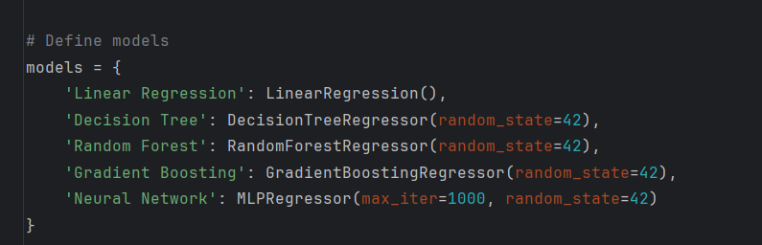
Implementation
A Gradient Boosting Regressor builds trees sequentially, each trying to correct the errors of the previous one.
Initialize the model with the number of estimators, learning rate, and maximum depth.
Fit the model by iteratively training decision trees on the residuals (errors) of previous predictions.
Update the predictions after each tree using a learning rate.
Make predictions by summing the initial prediction and the scaled outputs of all trees.

Slide 12
Obtained results, and their analysis.
Linear Regression:
-MAE (Mean Absolute Error): 39,430.17
-MSE (Mean Squared Error): 2,436,249,371.31
-RMSE (Root Mean Squared Error): 49,358.38
Linear Regression performed fairly well with a reasonable MAE and RMSE, indicating that the average prediction error is around $39,430, and the standard deviation of the errors is approximately $49,358.

Slide 13
Obtained results, and their analysis.
Decision Tree:
MAE: 57,864.36
MSE: 5,259,298,085.38
RMSE: 72,521.02
The Decision Tree model has the highest error metrics among all models, indicating it did not perform as well as the other models. This suggests it might be overfitting to the training data or not capturing the underlying patterns effectively.

Slide 14
Obtained results, and their analysis.
Random Forest:
MAE: 41,852.08
MSE: 2,761,282,018.34
RMSE: 52,547.90
Random Forest performed better than the Decision Tree but not as well as some of the other models. It has slightly higher error metrics than Linear Regression and Gradient Boosting, indicating it captured more complexity but also introduced more error.

Slide 15
Obtained results, and their analysis.
Gradient Boosting:
MAE: 39,474.75
MSE: 2,444,068,147.36
RMSE: 49,437.52
Gradient Boosting is one of the best performing models with error metrics very close to those of Linear Regression. This suggests that it is effective in capturing complex patterns in the data without introducing too much error.

Slide 16
Obtained results, and their analysis.
Neural Network:
MAE: 39,549.98
MSE: 2,449,157,772.12
RMSE: 49,488.97
The Neural Network model also performed well, with error metrics similar to those of Linear Regression and Gradient Boosting. This indicates that it can capture non-linear relationships in the data effectively.

Slide 17
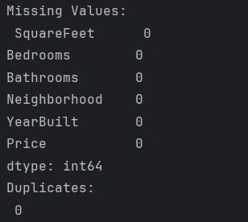
Obtained results, and their analysis.
Data Quality and Integrity:
- Missing Values: 0
- Duplicates: 0

Slide 18
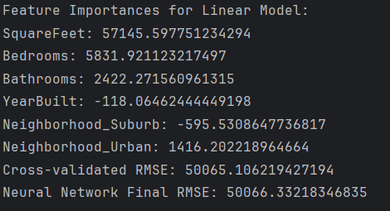
Obtained results, and their analysis.
SquareFeet has the highest positive impact on the housing price.
Bedrooms and Bathrooms also positively influence the price, though to a lesser extent.
YearBuilt has a slight negative impact, suggesting older houses might be valued slightly lower.
Neighborhood categories show varying impacts, with Urban areas having a positive influence compared to the reference category (assumed to be Rural or similar).
Notes:
Feature Importances for Linear Model
Feature importance indicates how much each feature contributes to the model's predictions. In a linear regression model, feature importance can be interpreted as the magnitude of the coefficients.
SquareFeet: 57145.597751234294
This high value suggests that the square footage of the house is the most significant factor influencing the price. A larger square footage likely leads to a higher price.
Bedrooms: 5831.921123217497
The number of bedrooms also has a positive impact on the house price, though much less than square footage.
Bathrooms: 2422.271560961315
The number of bathrooms has a smaller but still positive influence on the price.
YearBuilt: -118.06462444449198
The negative coefficient for the year built suggests that, contrary to expectations, newer homes might be slightly less valued compared to older homes, possibly due to the value of historical or established properties in certain markets.
Neighborhood_Suburb: -595.5308647736817
Living in a suburban neighborhood slightly decreases the price compared to the baseline (presumably rural or urban neighborhoods not explicitly listed).
Neighborhood_Urban: 1416.202218946664
Urban neighborhoods have a positive impact on the price compared to the baseline.
Cross-validated RMSE: 50065.106219427194
The Root Mean Squared Error (RMSE) from cross-validation of the linear regression model.
It provides an estimate of the model's prediction error on unseen data. Here, it indicates the typical deviation of the predicted house prices from the actual prices.
Neural Network Final RMSE: 50066.33218346835
The final RMSE for the custom neural network model. This value is very close to the RMSE of the linear model,
suggesting that both models have similar performance in terms of prediction error.

Slide 19
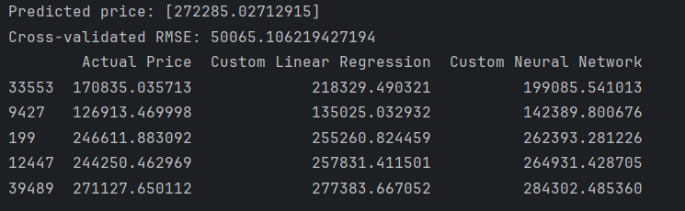
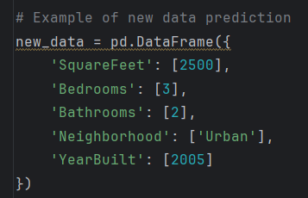
Obtained results, and their analysis
Predicted price: [272285.02712915]
This is the predicted price for a new data example using the best model saved after training.
The new data had the following features:

Slide 20
Obtained results, and their analysis
Cross-validated RMSE: 50065.106219427194
This value represents the Root Mean Squared Error (RMSE) calculated using cross-validation. It provides an estimate of the model's performance on unseen data. A lower RMSE indicates better predictive accuracy.

Slide 21
Obtained results, and their analysis
The table displays the Actual Price and the predicted prices from two models: Custom Linear Regression and Custom Neural Network. The predictions are compared against the actual prices for a sample of test data.
Notes:
Row 33553: Analysis: Both models over-predict the price compared to the actual price. The neural network prediction is closer to the actual value than the linear regression.
Row 9427: Analysis: Both models over-predict, but the linear regression model's prediction is closer to the actual price.
Row 199: Analysis: Both models over-predict, with the linear regression model being closer to the actual price.
Row 12447: Analysis: Both models over-predict, with the linear regression model being closer to the actual price.
Row 39489: Analysis: Both models over-predict, with the linear regression model being closer to the actual price.

Slide 22
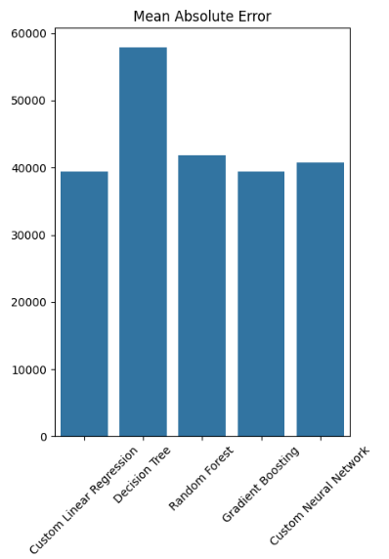
Obtained results, and their analysis.
MAE measures the average magnitude of errors in a set of predictions, without considering their direction. It’s a straightforward measure of prediction accuracy.
The Decision Tree model has the highest MAE, indicating the least accurate predictions.
Linear Regression, Gradient Boosting, and Neural Network models have similar and the lowest MAE values, suggesting they produce the most accurate predictions on average.

Slide 23
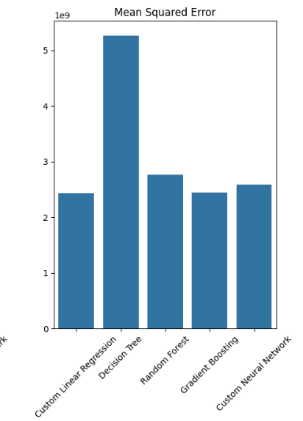
Obtained results, and their analysis.
MSE measures the average squared difference between the estimated values and the actual value. It gives more weight to larger errors, making it useful for identifying models that perform poorly due to large errors.
The Decision Tree model has the highest MSE, suggesting it produces larger errors compared to other models.
Linear Regression, Gradient Boosting, and Neural Network have similar and the lowest MSE values, indicating more stable performance with fewer large errors.

Slide 24
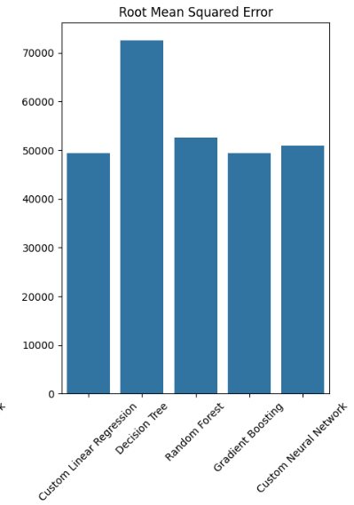
Obtained results, and their analysis.
RMSE is the square root of the average squared differences between predicted and actual values. It retains the same units as the target variable and gives a relatively high weight to large errors.
The Decision Tree model has the highest RMSE, reinforcing that it has the most considerable prediction errors.
Linear Regression, Gradient Boosting, and Neural Network have similar and the lowest RMSE values, indicating they have smaller prediction errors overall.

Slide 25

Evaluation
The Linear Regression model obtained the lowest overall normalized score, signifying its superior performance compared to the other models.
Error Metrics:
The Decision Tree model exhibited the highest values in MAE, MSE, and RMSE, reflecting the greatest number of errors among the models tested.
Model Insights:
Linear Regression: Successfully identified linear relationships between the features and housing prices.
Decision Tree and Random Forest: Created more intricate decision boundaries, though they had somewhat higher error rates.
Gradient Boosting: Displayed promise for enhanced performance with additional optimization.

Slide 26

Conclusion
This project successfully demonstrated the implementation of various machine learning algorithms to predict housing prices using a comprehensive dataset. By creating models from scratch, we gained a deep understanding of the mechanics and performance of these algorithms. Here are the key takeaways:
Model Performance:
Linear Regression, Gradient Boosting, and Neural Network models showed similar and relatively better performance compared to Decision Tree and Random Forest models, with Linear Regression achieving the lowest RMSE of 49358.38.
Decision Tree Regressor had the highest error metrics, indicating it may not be suitable for this dataset without further tuning.
Model Selection and Deployment:
The Linear Regression model was selected as the best model based on RMSE and saved for future predictions. This model provides a balance between simplicity and performance.
Prediction:
The best model was successfully used to predict the price of new housing data, showcasing the model's practical application in real-world scenarios.
Future Work
Feature Engineering:
Additional feature engineering, such as creating interaction terms or using external data sources, could uncover more significant relationships and improve model accuracy.
Validation:
Implementing cross-validation more rigorously and exploring different train-test splits can ensure the models generalize well to unseen data.

Slide 27

Thank You!
Questions/Answers

